Slide 1
IBM Bluemix PaaS Java Developers Dream come true
IBM Cloud Ecosystem Development

Slide 2

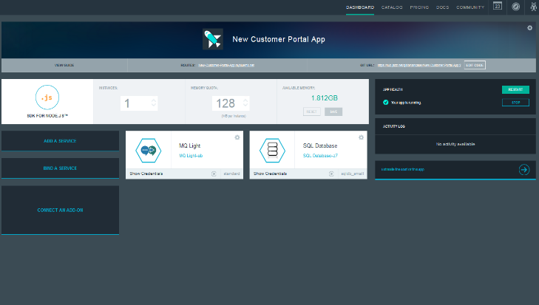


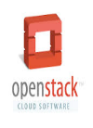

Bluemix: IBM’s Cloud Platform
Build, run, scale, manage, integrate & secure applications in the cloud
Developer experience
Rapidly deploy and scale applications in any language.
Compose applications quickly with useful APIs and services and avoid tedious backend config.
Realize fast time-to-value with simplicity, flexibility and clear documentation.
Enterprise capability
Securely integrate with existing on-prem data and systems.
Choose from flexible deployment models.
Manage the full application lifecycle with DevOps.
Develop and deploy on a platform built on a foundation of open technology.
Built on a foundation of open technology.
Bluemix service categories
DevOps
Big Data
Mobile
Watson
Business Analytics
Database
Web and application
Security
Internet of Things
Cloud Integration

Slide 3
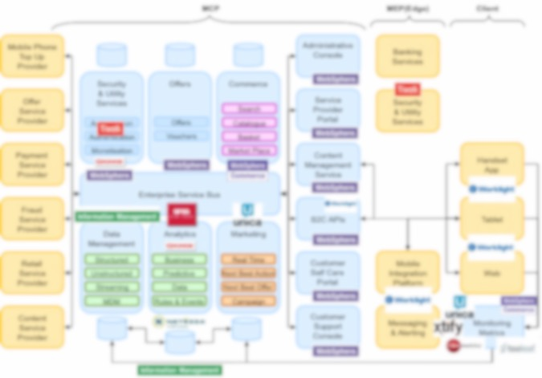
Bluemix is becoming part of complex solutions
Bluemix
Notes:
Key themes
Speed
Instant environments
Quick deployments
Sign up in minutes
Ease of Use
Instant Environments
Services prebuilt for your use - IBM, Third Party, Community
DevOps tools to monitor, plan, deploy, and manage your apps
Flexibility
On-Prem integration
Flexible pricing
Security
IBM secures the platform and infrastructure - leveraging experience with softlayer and proven on-prem security implementations
Provides you with the tools to secure your apps

Slide 4
Bluemix Platform Architecture
DevOps/BOSH
IPS
Reverse Proxy, SSL termination
Services
Application User Flow
Authorization
Application
Runtimes
(DEA)
Services
S
E
R
V
I
C
E
G
A
T
E
W
A
Y
Cloud Foundry Control Elements
Developer Provisioning & DevOps Flow
F
I
R
E
W
A
L
L
D
A
T
A
P
O
W
E
R
Blob
Store
Application container isolation
R
O
U
T
E
R
Cloud
Controller
Health
Manager
NATS
(Messaging)
CCDB
Metering
ACE Dashboard
Services
BSS
UAA/
Login Server
Node
Node
Node
Login
Flow
Authentication
Single Sign On Service
Operating System security hardening
Network security
VLAN 1
VLAN 2
IBM Web ID
Operational Security Services (IBM Endpoint Manager, QRadar, Nessus, User Access Management)
Notes:
Application User Flow
Provisioning of Services & DevOps Flow
Login Flow : IBM Web ID goes through the verticals namely Firewall, DataPower and the Router.

Slide 5
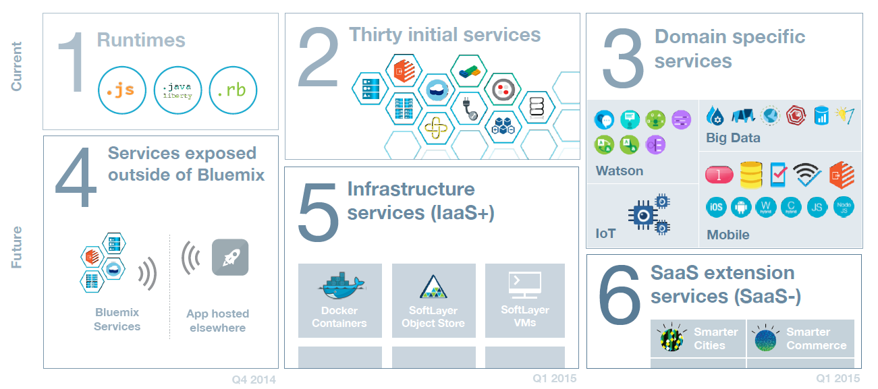
Evolving Bluemix Platform Bring full range of developer services into Bluemix
Services | Integration | Portability
Flexible Deployment Models
5

Slide 6
Java Buildpacks
Intro to Liberty Buildpack

Slide 7
Responsibility of Liberty Buildpack
Converts VCAP_SERVICES and VCAP_APPLICATION environment variables into configuration variables
Variables end up in runtime-vars.xml
Generates configuration for bound services
Auto wires resource references to cloud services
Starts & Stops Liberty server
Controls process environment
Generates Liberty server configuration for war/ear files
Pulls additional Liberty runtime packages as needed by Apps
Notes:
The buildpack will convert VCAP_SERVICES and VCAP_APPLICATION environment variables provided by CF into configuration variables for the Liberty server.
The variables end up in runtime-vars.xml, and are therefore referenceable from a pushed server.xml
For example ${vcap_app_port}: The port where the app server is listening (usually the same as ${port})
The buildpack will auto generate configuration for the bound services
The buildpack will auto wire multiple resources references to the appropriate cloud service resource
The buildpack will be responsible for starting and stopping the Liberty server and controlling the process environment
Generate the Liberty server configuration when war/ear files are pushed
Pull in additional Liberty runtime packages when the pushed applications need them

Slide 8
Liberty Buildpack vs Java Buildpack
 | Liberty buildpack | Java buidlpack
Application server | WebSphere Liberty profile – Java EE 6/7 Web Profile & Beyond | Apache Tomcat 8 – Servlet 3.1, JSP 2.3, EL 3.0, WebSocket 1.1
Java runtime | IBM JRE or OpenJDK | OpenJDK
Supported Java Web applications | WAR, EAR, server directory or package | WAR
Configuration | Configuration can be provided with application or via environment variables | Must fork to customize configurations for many scenarios
Service integration | Auto-configuration for 14 services | Auto-configuration for 5 services
Support statement | IBM supported | Community supported
Performance | Better performance (push time, memory footprint, throughput, scaling time)
Developer aids | Remote debugging & incremental update support, health center access, shell access
Notes:
EL 3.0 = Expression Language
Auto Configuration of Bound Services : https://www.ng.bluemix.net/docs/starters/liberty/index.html#automaticconfigurationofboundservices
SQL Database
ClearDB MySQL Database
MySQL
ElephantSQL
PostgreSQL
Cloudant® NoSQL Database
MongoLab
dashDB™
Data Cache
Session Cache
MQ Light
Monitoring and Analytics
Auto-Scaling
Single Sign On
New Relic
https://www.ng.bluemix.net/docs/#starters/liberty/index.html#liberty : Autoconfiguration for 14 services
Set the Liberty features with the JBP_CONFIG_LIBERTY environment variable or deploy your application as a server directory or packaged server with a custom server.xml file. Setting this environment variable ensures that your application uses only the feature that it needs and it is not affected by the buildpack's default Liberty feature set changes. If you need to provide extra Liberty configuration beyond the feature set, use the server directory or the packaged server option to deploy your application.

Slide 9
Easier configuration with Liberty buildpack
What it takes to make the following configuration change:
Configuration | with Liberty buildpack | with Java buildpack
JRE choice | Repush: IBM JRE or OpenJDK | Fork the buildpack
JRE overlay | Repush: include overlay files in app package | Fork the buildpack
Server customization | Repush: use server package | Fork the buildpack
JVM options | Repush or Restart | Repush
Notes:
There are some cases where files need to be bundled with the JDK in order to expose functionality in the runtime JVM. For example, the inclusion of unlimited strength Java Cryptography Extensions (JCE) is often added to a JDK in order to utilize stronger cryptographic libraries. To handle such cases, files designated by the app in a .jdk-overlay folder into the JDK’s directory structure.

Slide 10
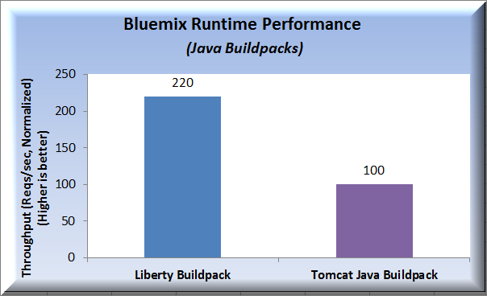
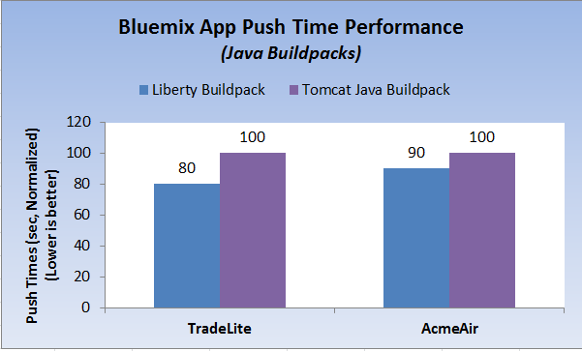
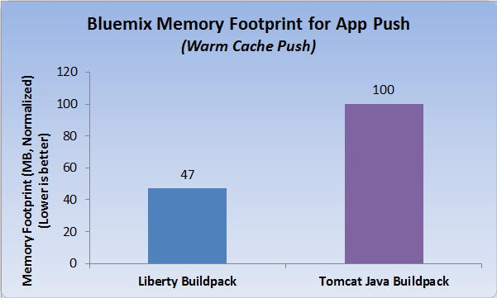
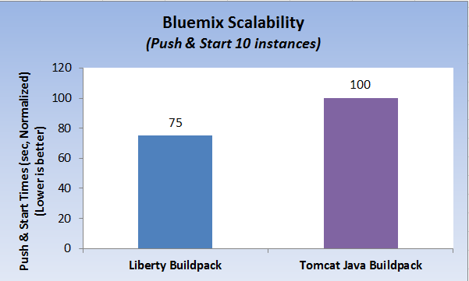
Performance comparison

Slide 11
A Java Developer Perspective
To the Cloud..

Slide 12
Bluemix Tools at a glance
Pivotal CF Tools
IBM Eclipse Tools for Bluemix
Vendor-specific extensions
Cloud Foundry (CF) Eclipse Tools
Open source CF framework
Vendor neutral support for all CF environments
Eclipse + Web Tools Platform (WTP)
Eclipse open source projects
We develop and contribute to all 3 layers (WTP, CF Eclipse Tools and IBM Eclipse Tools for Bluemix)
Notes:
Let’s take a look at Bluemix tools. We have IBM Eclipse Tools for Bluemix and Pivotal Cloud Foundry Tools which are Vendor specific extensions, built on top of Cloud Foundry Eclipse Tools. The CF tools provide vendor neutral support for all Cloud Foundry environments. The Cloud Foundry Eclipse Tools are built on Eclipse and Web Tools Platform.

Slide 13
IBM Eclipse Tools for Bluemix
Eclipse is IDE of choice
Develop, build, deploy apps to Cloud quickly & easily
Currently target IBM supported (Tier 1) runtimes
Liberty for Java
Node.js
Notes:
Eclipse is standard IDE environment for developing applications. The IBM Eclipse Tools are based on Cloud Foundry Eclipse Tools. They allow developers to develop, test and push applications to the Cloud directly within Eclipse. These tools support the Tier 1 runtimes namely Liberty for Java and Node.js.

Slide 14
IBM Eclipse Tools for Bluemix Powerful & Versatile DevOps tools
Ops Tools for Sever lifecycle:
Creation, Removal, Start, Stop, Restart
Ops Tools for lifecycle of Applications
Deploy, Remove, Update, Restart
Dev Tools supporting Architect & Developer
Compose applications by creating and binding services
Run, Debug, Profile
Tune
Local & Remote Support
Notes:
Versatile DevOps Tools.
IBM Eclipse Tools for Bluemix enable us to create Bluemix server and connect to it.
We can deploy applications directly to Bluemix Server, within Eclipse, namely WAR, EAR files. The tools provide capability to tune Bluemix Server, edit Application Information as well as deployed Application Instance information. We can create services and bind them to application instance, edit Environment variables and debug remotely.

Slide 15
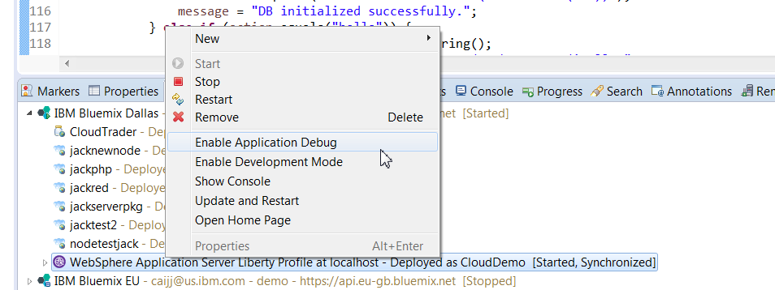
Development Mode
Special mode of application instance
Allows dev operations
Remote debugging
Incremental update
Notes:
Special mode of application instance
Allows the app developer to conduct various development operations.
Remote debugging
Incremental update

Slide 16
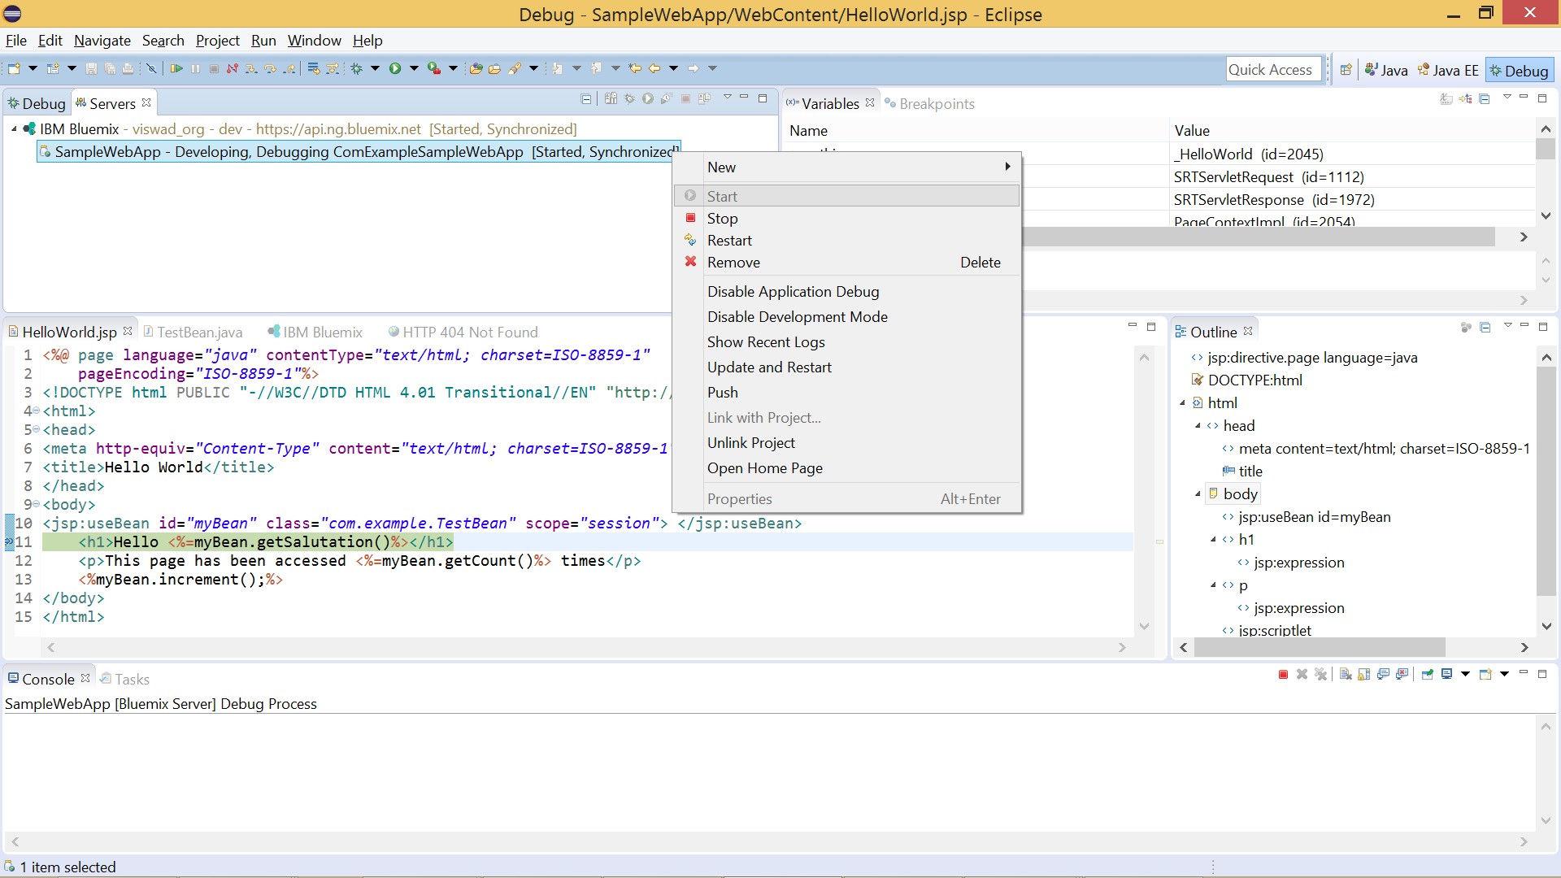
Remotely Debug Applications in Bluemix
App in Dev & Debug mode
Inspect variables
Set break points

Slide 17
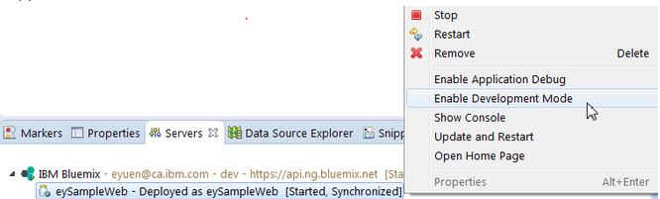
Incremental Publish of Apps in Bluemix
Enable Development Mode
Enabling Development Mode provides access to
Push incremental file updates
Run additional tools inside app container like SSH web console
Notes:
Earlier, one had to deploy the entire application for a simple change in the App. With incremental publish support, you can publish only the changed files to Bluemix and the changes will take place immediately without a redeploy of the entire application.
After an application has been deployed to Bluemix, you can right click on the application from the Servers view and select Enable Development Mode. When the application is running in Development Mode, you can incrementally publish your application to Bluemix by clicking the Publish button.

Slide 18
Three Hands-on Labs

Slide 19
Consuming Services
From Java Applications

Slide 20
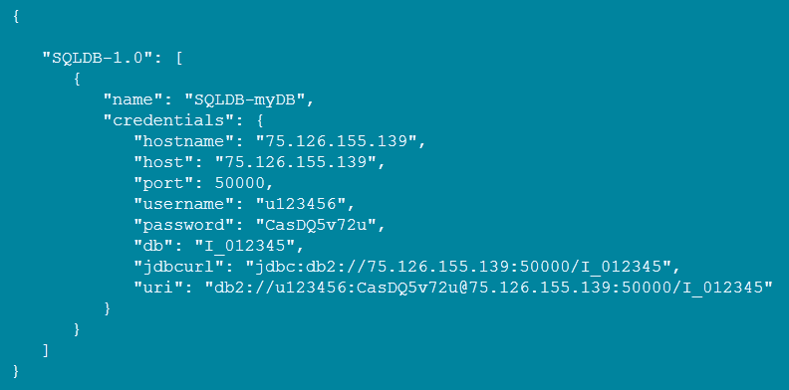
Using a service in Bluemix
Create & Bind service
Command line
cf marketplace to see available services
cf create-service to create a service instance
cf bind-service to bind the service instance to your application
cf restart, or cf push again
Web portal (bluemix.net)
Read service connection and credentials
Sample VCAP_SERVICES environment variable
Notes:
The plain way to use a service in Bluemix :

Slide 21
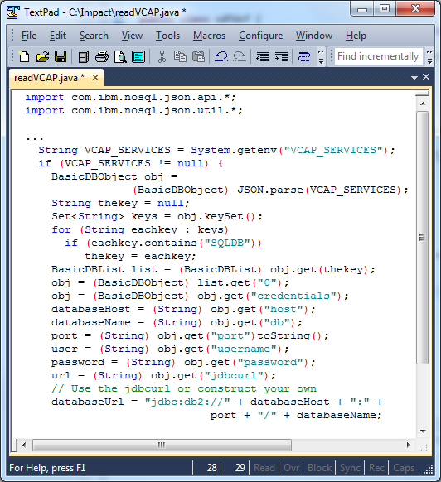
Sample code to connect to a SQL service Read the credentials
Notes:
import com.ibm.nosql.json.api.*;
import com.ibm.nosql.json.util.*;
...
String VCAP_SERVICES = System.getenv("VCAP_SERVICES");
if (VCAP_SERVICES != null) {
BasicDBObject obj =
(BasicDBObject) JSON.parse(VCAP_SERVICES);
String thekey = null;
Set<String> keys = obj.keySet();
for (String eachkey : keys)
if (eachkey.contains("SQLDB"))
thekey = eachkey;
BasicDBList list = (BasicDBList) obj.get(thekey);
obj = (BasicDBObject) list.get("0");
obj = (BasicDBObject) obj.get("credentials");
databaseHost = (String) obj.get("host");
databaseName = (String) obj.get("db");
port = (String) obj.get("port")toString();
user = (String) obj.get("username");
password = (String) obj.get("password");
url = (String) obj.get("jdbcurl");
// Use the jdbcurl or construct your own
databaseUrl = "jdbc:db2://" + databaseHost + ":" +
port + "/" + databaseName;
}

Slide 22
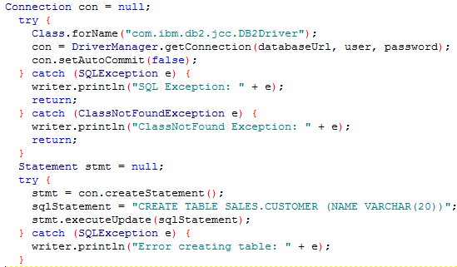
Sample code to connect to a SQL service
Establish the connection
22
Notes:
Connection con = null;
try {
Class.forName("com.ibm.db2.jcc.DB2Driver");
con = DriverManager.getConnection(databaseUrl, user, password);
con.setAutoCommit(false);
} catch (SQLException e) {
writer.println("SQL Exception: " + e);
return;
} catch (ClassNotFoundException e) {
writer.println("ClassNotFound Exception: " + e);
return;
}
Statement stmt = null;
try {
stmt = con.createStatement();
sqlStatement = "CREATE TABLE SALES.CUSTOMER (NAME VARCHAR(20))";
stmt.executeUpdate(sqlStatement);
} catch (SQLException e) {
writer.println("Error creating table: " + e);
}

Slide 23
Java EE Resource Auto-wiring for services
23
Notes:
Auto wiring is available for Spring applications : http://docs.cloudfoundry.org/buildpacks/java/spring-service-bindings.html

Slide 24
How does Auto Wiring work ?
Look for resource using JNDI name java:comp/env/jdbc/myDB
Bind service with name ‘myDB’ which is mapped to JNDI name jdbc/myDB
Bound service returned as result of lookup
Notes:
Application does a lookup for a resource using the JNDI name java:comp/env/jdbc/myDB
Service bound with name ‘dbService’ which is mapped to JNDI name jdbc/dbService
Allows the single service that is bound to be returned as the result of the lookup

Slide 25
Auto configuration of Liberty server
During App Staging :
Buildpack service plugin examines VCAP_SERVICES → Generates server.xml snippets
Before
After
<server>
<featureManager>
<feature>webProfile-6.0</feature>
</featureManager>
…
</server>
<server>
<featureManager>
<feature>webProfile-6.0</feature>
<feature>eXtremeScale.webapp-1.1</feature>
</featureManager>
…
<xsWebApp
objectGridName=“${cloud…}“
catalogHostPort=“${cloud…}"
securityEnabled=“${cloud…}" />
</server>
Notes:
When an application is staged, the buildpack service plugin examines the bound service information by looking at VCAP_SERVICES variable & generates the corresponding server.xml snippets (includes host, port and security features) for the bound services

Slide 26
Auto configuration of Liberty server
Opt-out of Auto configuration when :
Generated config is not correct
Service plugin cannot discern intent correctly
Opt-out per service
Set services_autoconfig_excludes environment variable
Notes:
When an application is staged, the buildpack service plugin examines the bound service information by looking at VCAP_SERVICES variable & generates the corresponding server.xml snippets (includes host, port and security features) for the bound services
https://www.ng.bluemix.net/docs/#starters/liberty/index.html#liberty
For automatically configured services, the Liberty buildpack generates or updates service binding entries in the server.xml file. The contents of the service binding entries can be in one of the following forms:cloud.services.<service-name>.<property>, which describes the information such as the name, type, and plan of the service.
cloud.services.<service-name>.connection.<property>, which describes the connection information for the service.
The typical set of information is as follows:name: The name of the service. For example, mysql-e3abd.
label: The type of the created service. For example, mysql-5.5.
plan: The service plan, as indicated by the unique identifier for that plan. For example, 100.
connection.name: A unique identifier for the connection, which takes the form of a UUID. For example, d01af3a5fabeb4d45bb321fe114d652ee.
connection.hostname: The host name of the server that is running the service. For example, mysql-server.mydomain.com.
connection.host: The IP address of the server that is running the service. For example, 9.37.193.2.
connection.port: The port on which the service is listening for incoming connections. For example, 3306,3307.
connection.user: The user name that is used to authenticate this application to the service. The user name is auto-generated by Cloud Foundry. For example: unHwANpjAG5wT.
connection.username: An alias for connection.user.
connection.password: The password that is used to authenticate this application to the service. The password is auto-generated by Cloud Foundry. For example: pvyCY0YzX9pu5.
For bound services that are not automatically configured by the Liberty buildpack, the application needs to manage the access of the backend resource on its own.
some services can be application managed, or container managed. Mongo and SQLDB are examples of such services. By default, the Liberty buildpack assumes that these services are container managed and automatically configures them. If you want the application to manage the service, you can opt-out of automatic configuration for the service by setting the services_autoconfig_excludes environment variable. For more information, see Opting out of service auto-configuration.

Slide 27














Services easy to consume in IBM Cloud
Java EE standard “resources”
SQL Database
BLU Data Warehouse
Elastic MQ
Modern “resources”
Cloudant
Data Cache
Mongo DB
Operational services
Session Cache
Auto Scaling
Monitoring and Analytics
Log Analysis
Notes:
27

Slide 28
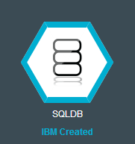
Using SQLDB service
SQLDB is on-demand relational database, powered by DB2.
How you can use it?
The plain “VCAP_SERVICES” way
The Java EE way
DataSource
JPA

Slide 29
Java EE way – Sample code for SQLDB
“mydb” is the name of service instance you create in Bluemix
public class TestServlet extends HttpServlet {
@Resource (name = "jdbc/mydb") private DataSource db;
...
protected void doGet(HttpServletRequest request, HttpServletResponse response) throws ServletException, IOException {
// Alternatively use InitialContext lookup DataSource lookup = (DataSource) new InitialContext().lookup("jdbc/mydb");
...
}
That’s it! All familiar code, no changes required to make it work in cloud!
No need for a server.xml
Don’t need to read VCAP_SERVICES

Slide 30

Using ElasticMQ service – familiar way again!
Develop responsive, scalable applications with a fully managed messaging provider in cloud.
public class TestServlet extends HttpServlet {
@Resource (name = "jms/emq") private ConnectionFactory cf;
...
protected void doGet(HttpServletRequest request, HttpServletResponse response) throws ServletException, IOException {
// Alternatively use InitialContext lookup ConnectionFactory lookup =
(ConnectionFactory) new InitialContext().lookup(“jms/myemq");
...
}

Slide 31
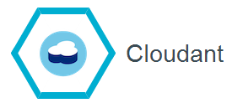
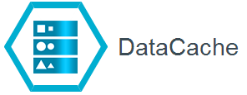
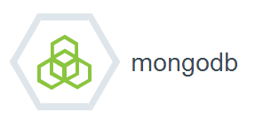
More services accessible same way
Cloudant’s distributed database as a service (DBaaS) allows developers of fast-growing web and mobile apps to focus on building and improving their products, instead of worrying about scaling and managing databases on their own.
Improve the performance & user experience of web applications by retrieving information from fast, managed, in-memory caches, instead of relying entirely on slower disk-based databases.
MongoDB is an open source document database and the leading NoSQL database that is owned by MongoDB Inc
31
Notes:
Cloudant <demo>
MongoDB
Data Cache
List the brief introduction and ICON for all 3 here.
List sample code for each of them in the following 3 slides.

Slide 32
Cloudant
“mycloudantdb” is the name of the service instance you create in Bluemix
public class TestServlet extends HttpServlet {
@Resource (name = “cloudant/mycloudantdb") private CouchDbInstasnce db;
...
protected void doGet(HttpServletRequest request, HttpServletResponse response) throws ServletException, IOException {
// Alternatively use InitialContext lookup CouchDbInstance db = (CouchDbInstance) new InitialContext().lookup("java:comp/env/cloudant/mycloudantdb");
CouchDbConnector dbc = _db.createConnector(DATABASE, true);
CouchDocument dbentry = new CouchDocument();
dbentry.setContent("testEntry");
dbc.create(dbentry);
}

Slide 33
DataCache
“myGrid” is the name of the service instance you create in Bluemix
public class TestServlet extends HttpServlet {
@Resource (name = “wxs/myGrid") private ObjectGrid og;
...
protected void doGet(HttpServletRequest request, HttpServletResponse response) throws ServletException, IOException {
// Alternatively use InitialContext lookup ObjectGrid og = (ObjectGrid) new InitialContext().lookup(“wxs/myGrid");
...
}

Slide 34
Mongo
“mymongo” is the name of the service instance you create in Bluemix
import com.mongodb.DB;
public class TestServlet extends HttpServlet {
@Resource (name = “cloudant/mymongo") private DB db;
...
protected void doGet(HttpServletRequest request, HttpServletResponse response) throws ServletException, IOException {
// Alternatively use InitialContext lookup db = (DB) new InitialContext().lookup("java:comp/env/cloudant/mymongo");
...
}

Slide 35





IBM Application Server on Cloud for Bluemix reduces deployment time, increases consistency, and fosters agility. These benefits you likely expect when exploring cloud-based approaches for your WAS environments.
WebSphere Application Server
Bluemix
IBM Application Server on Cloud
for Bluemix
Same WAS you Know and Love; Same features & capability but gaining the Cloud
Your Route to get your applications to the Cloud. Build, run, deploy and manage applications on the cloud with ease.
Takes WAS to the Next Level with comprehensive cloud orchestration to help you Extend and Evolve.
Innovative App Server
Flexible runtime environment for a lightweight, dynamic application runtime or an advanced, large-scale application platform.
Extend apps with services
A catalog of IBM, third party, and open source services to grow your solution.
Lift & Shift WAS to Cloud
Rapidly bring your Apps to Cloud & Drive faster solution delivery ahead of the competition
Rapidly deliver Rich Experiences
Comprehensive set of open standards programming models to better align project needs with capabilities and developer skills.
Flexible Pricing
Try some services for free and when you’re ready, pay only for what you use. Pay as you go and subscription models offer choice and flexibility.
Best of Both Worlds
Balance Cloud Economics & Agility with WAS quality, security and governance.

Slide 36
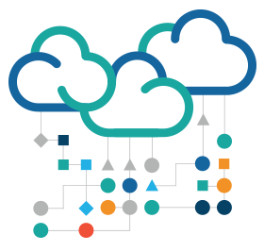
IBM Application Server on Cloud provides Middleware-as-a Service for WebSphere Application Server Workloads.
Capabilities of Bluemix now span IaaS through PaaS .
Infrastructure as a Service
IBM Application Server on Cloud
Platform as a Service
Middleware as a Service
Code
Code
Code
Data
Data
Data
Runtime
Runtime
Runtime
Middleware
Middleware
Middleware
OS
OS
OS
Virtualization
Virtualization
Virtualization
Servers
Servers
Servers
Storage
Storage
Storage
Networking
Networking
Networking
IBM Pre-configured, Customer Accessible
Customer Managed
IBM Managed

Slide 37





IBM Application Server on Cloud provides the Same WebSphere Application Server with the Speed and Simplicity of the Cloud!
Develop, Test and Run
IBM Application Server on Cloud
Code
Traditional WebSphere |  | Robust , Proven & Consistent Java Runtime WebSphere Application Server provides the optimal infrastructure for a wide spectrum of emerging workloads. Identical Interfaces & Experience for Developers and Operations.
Cloud Enabled |  | Deploy WAS applications in the Cloud seamlessly Bring your Traditional WAS & Liberty application to pre-optimized off-premise hosting environment without change.
Do More with Less |  | Reduce capital expenditures and operational expenses Leverage Pay-as-You-GO or Subscription to WAS workloads in repeatable and reliable deployments in the Cloud. You can achieve savings by optimizing labor efficiency with hosted hardware consolidation & utilization.
Faster |  | Accelerate WAS Application Delivery in the Cloud Compared to “Roll your Own”, Deploy apps into test and/or production in minutes, not months. Increase ability to quickly deliver results to capitalize on business opportunities.
Data
Runtime
Middleware
OS
Virtualization
Servers
Storage
Networking
IBM Pre-configured, Customer Accessible
Customer Managed
IBM Managed

Slide 38

IBM Application Server on Cloud provides the Building Blocks ,
Standardized virtual machines, pre-configured through automation with self-serviced consumption based pricing.
Develop, Test and Run
WebSphere Application Server workloads
Deploy Virtual Machines based on – Full Profile & Liberty Core
IBM Application Server on Cloud
1
Code
Data
Runtime
Integrated Bluemix UI Portal
Includes Simple administration, management, monitoring, connectivity info, ..etc
Middleware
2
OS
Virtualization
Servers
Bluemix Public Infrastructure & Billing
Shared Multi-Tenant WAS VMs for Hourly PayGo or Monthly Subscription
Storage
3
Networking

Slide 39
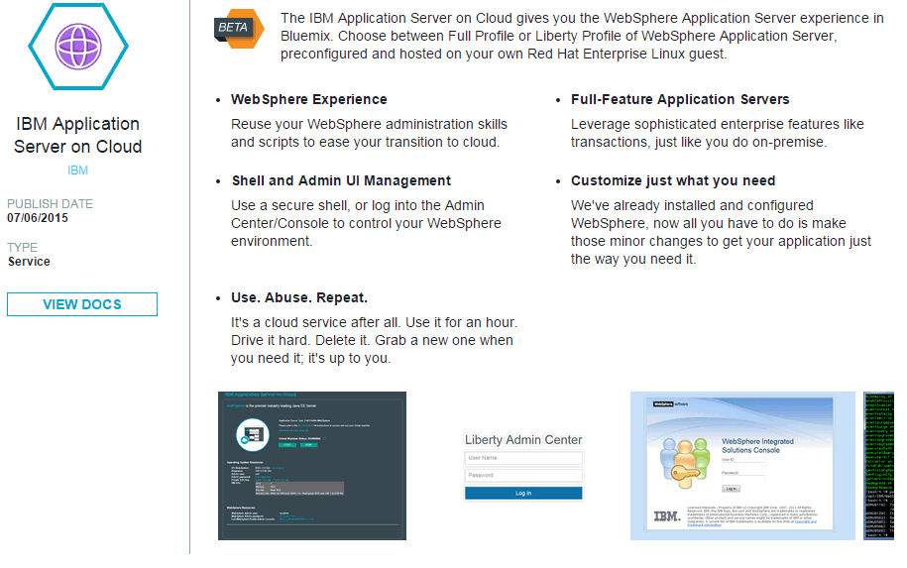
IBM Application Server on Cloud provides Portability from on-prem
Quickly get up and running on pre-configured WAS Classic and WAS Liberty Virtual Machines in a hosted cloud environment on Bluemix with Full control of the underlying OS & middleware.
IBM Application Server on Cloud
Code
Data
Runtime
Middleware
OS
Virtualization
Servers
Storage
Networking

Slide 40


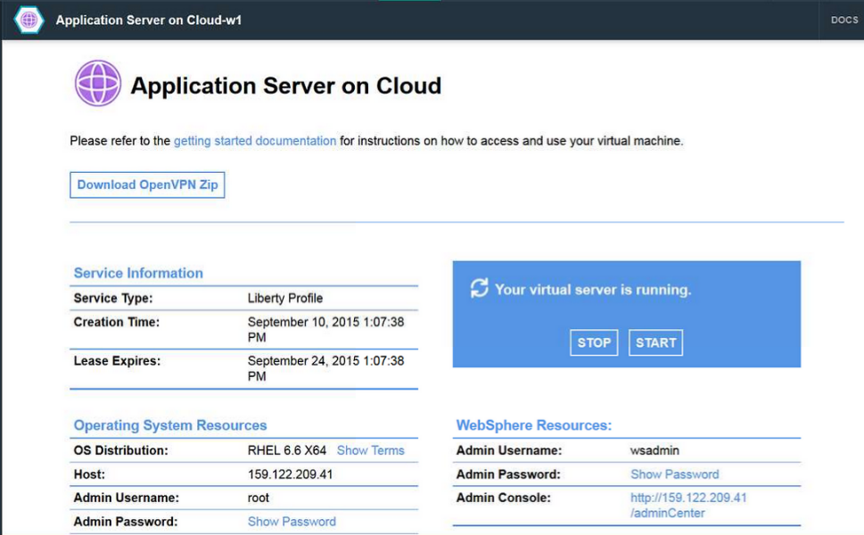
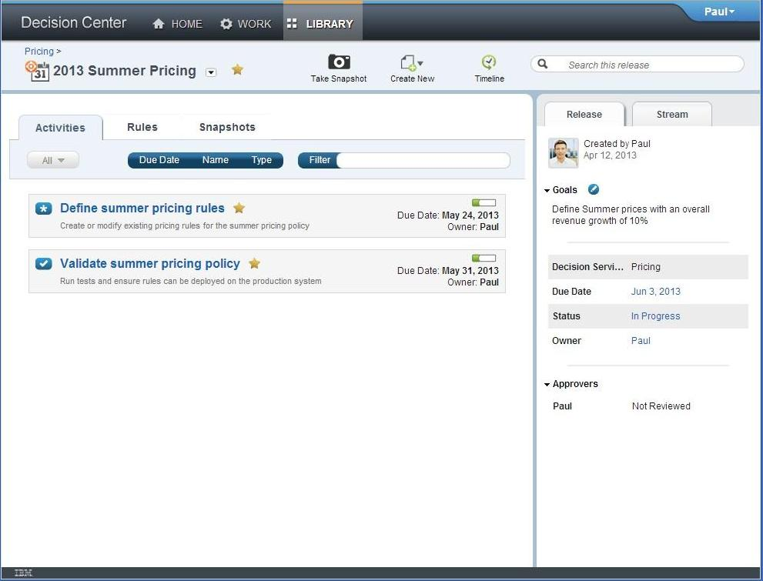
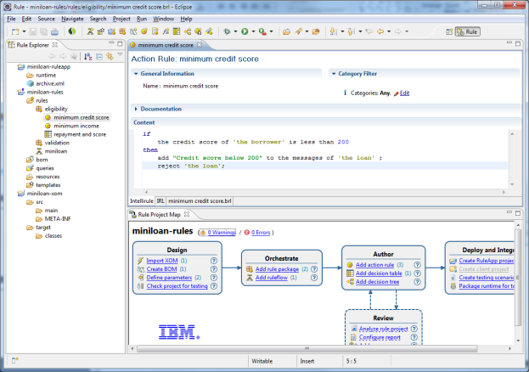
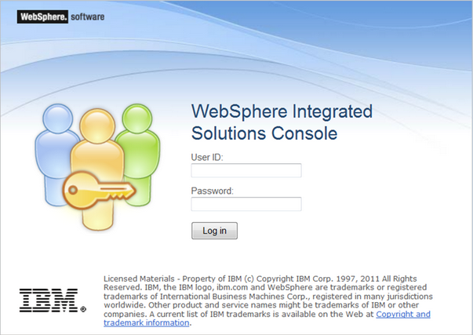
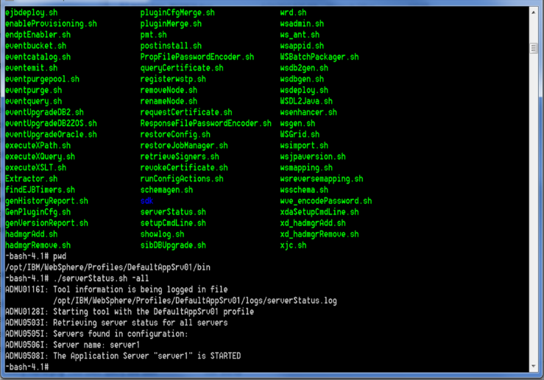
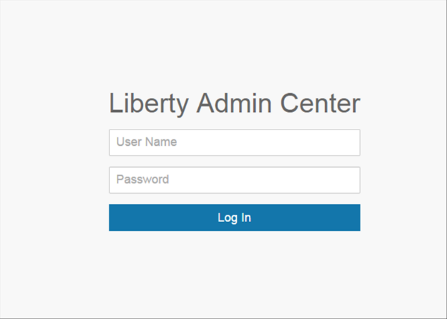
IBM Application Server on Cloud includes a Dashboard providing
Ease of Administration of Virtual Machine Environments allowing Customer to focus on Application Development & Application Integration
Service Dashboard
Customer access:
Documentation
OpenVPN configuration
Start and Stop virtual machines
Hostname, Root & OS password.
Private SSH key
WebSphere Admin User & Password.
Admin Center and Admin Console Urls.
WebSphere Application Server Developers, Testers
Administrators
SSH Access to VMs
Admin Center and Admin Console Links

Slide 41



IBM Application Server on Cloud provides easy Data integration and Enterprise Connectivity
Integration and data capabilities are accessible making hybrid application architecture even easier and more flexible.
VPN
Leverage OpenVPN for secure connection to Systems of Record running in your network
Develop, Test and Run
IBM Application Server on Cloud
Code
Data
Runtime
SoR
Middleware
Calls to Systems of Record
OS
Virtualization
Servers
Secure Gateway
Storage
Networking
Securely access data and applications in other clouds, enterprise data centers and locally on developer laptops

Slide 42
IBM Application Server on Cloud popular Starter Usecases.
Internal Pilot project
Proving the business value of new projects
Try out a newer version of WebSphere Application Server for short period of time
Hybrid cloud development
As a development environment for WebSphere Application Server
Get started fast during on-prem WebSphere Application Server installation/set-up is in parallel
Instead of their own WAS Installation
Prefer Cloud solutions to on-prem Licensed product
Organizations with small IT departments
As a target for clients struggling with their own on-prem or RYO WAS Cloud infrastructure
Urgency for implementation (Quick Time to Value)
Develop, Test and Run
IBM Application Server on Cloud
Code
Data
Runtime
Middleware
OS
Virtualization
Servers
Storage
Networking
Notes:
Add to Bluemix …

Slide 43


Sign up in minutes. Pay for what you use.
Cloud based pricing models to serve customer needs.
Friction free adoption
10 Instance Hours Included each Month - Designed to allow testing of an application on the platform
IBM manages:
24/7 Support
Platform Configuration
Platform Uptime
Platform Monitoring
Platform High Availability
High Availability
WAS Product Updates
Platform Scheduled Maintenance with advanced notice
Free tier for many Bluemix service - encourages experimentation of new services for applications already running on Bluemix
Multiple Commitment Models
Pay-as-you-go - optimized for flexibility, no term commitment
Customer manages
Subscription - term based optimized for cost, discounted from pay as you go rates
WAS Maintenance
Version updates on customer’s schedule
Self Service
Capacity and scaling
Zero to coding in less than 5 minutes
By default, we provide capacity in customer’s regional data center. Additional capacity available by adding my Instances!
Credit card over the web in many countries - or through your IBM rep

Slide 44
IBM Application Server on Cloud provides Simple Plan Options
One Instance of a plan equates to 1vCPU with 2GB RAM, and 12Gig HD capacity priced by Instance-Hr
BYOL Plan
Current Active WAS S&S Customer can bring licenses of WAS to run on this Offering. This plan will deploy Pre-configured WAS based on existing entitlement. (Subscription Only)
$0.30/Hr or $222/Mo
Develop, Test and Run
IBM Application Server on Cloud
Code
Liberty Core Plan
Pre-configured Instances based on Liberty Core
$0.41/Hr or $304/Mo
Data
Runtime
WAS Base Plan
Pre-configured Instances based on WebSphere Application Server Full Profile.
$0.52/Hr or $389/Mo
Middleware
OS
WAS ND Plan
Pre-configured Instances based on WebSphere Application Server Network Deployment
.
$1.14/Hr or $845/Mo
Virtualization
Servers
Storage
(Optional) Bluemix Standard Support
Developers forum.
Ticketing system with 24-hour responsiveness.
Connect with IBM technical staff.
Covers IBM Bluemix offerings and features.
10% of account charges, with a minimum monthly charge of $200.00 USD
Networking
Approximate monthly Price based on 744 Instance Hours per month.

Slide 45
Backup

Slide 46
Using Operational Services

Slide 47
Using operational services
Session Cache
Application Auto-Scaling
Log Analysis
Monitoring
47
Notes:
No code necessary.
Configure? and bind them.

Slide 48

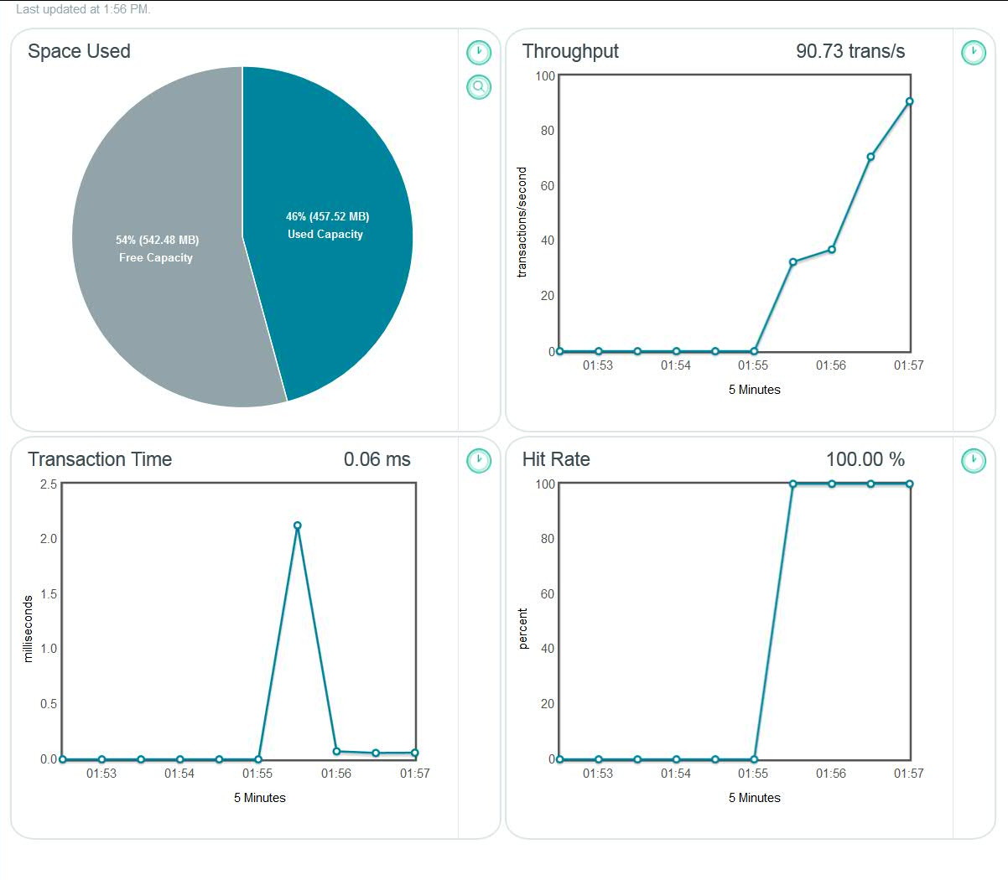
Session Cache
Improve application resiliency by storing session state information across many HTTP requests.
Enable persistence HTTP sessions for your application & seamless session recovery in event of an application failure.
48
Notes:
No code necessary.
Configure? and bind them.

Slide 49
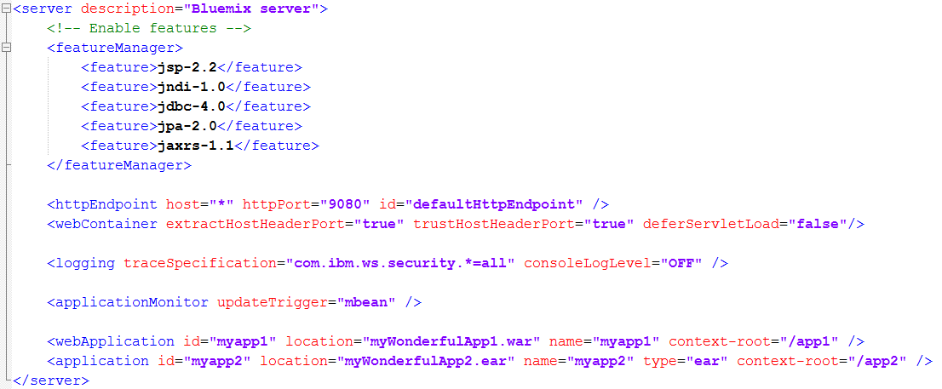
Liberty server dir/package
A server package
Use “./bin/server package myServer --include=usr” to create it
Or, simply a server directory
myServer
server.xml
apps
myWondefulApp1.war
myWondefulApp2.ear
Now you take full control!

Slide 50
You can also turn off Auto-Configuration and get the control
Connection info in runtime-vars.xml as variables
Provide a server.xml that reads these variables
Push server package
myServerPackage.zip
wlp
usr
servers
defaultServer
server.xml
apps
myapp.war
50

Slide 51
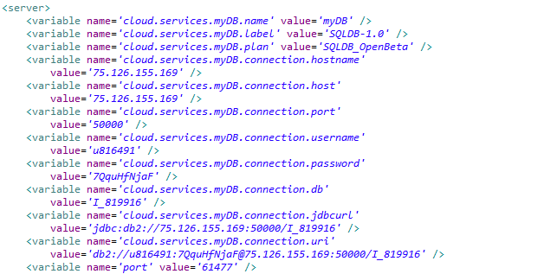
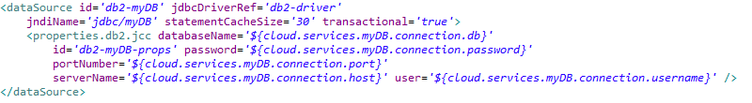
You can also turn off Auto-Configuration and get the control
variables available via runtime-vars.xml (provided)
server.xml (you provide)
51

Slide 52
Deploying Liberty applications to Bluemix
Server centric paradigm
Focus on runtime infrastructure available in the cloud
server.xml provided along with the application
User understands how to configure Liberty for their application
User wants that configuration reflected in the cloud deployment
Cloud centric paradigm
Focus on the application, not on the runtime infrastructure
server.xml is generated by the buildpack
User does not have to configure the Liberty server instance
User expects the environment to just do the right thing in order for their application to run

Slide 53
Supported Application Types
cf push - Push a single app (with or without a manifest):
cf push APP [-b BUILDPACK_NAME] [-c COMMAND] [-d DOMAIN] [-f MANIFEST_PATH] [-i NUM_INSTANCES] [-m MEMORY] [-n HOST] [-p PATH] [-s STACK] [-t TIMEOUT] [--no-hostname] [--no-manifest] [--no-route] [--no-start]
Standalone jar files (*.jar)
Web Applications (*.war)
Enterprise Applications (*.ear)
Liberty profile server package (*.zip)
Liberty profile server directory (dir.)
https://www.ng.bluemix.net/docs/Liberty/LibertyApp.html

Slide 54
Support Statement for Java apps deployed to Bluemix
We will keep two Liberty buildpacks in bluemix
Latest and one back
Buildpacks can be explicitly targeted with the –b option
Default Liberty Buildpack will always be the latest valid service level
Cumulative service will only be provided on the latest Buildpack level
We will retire any level of the buildpack as we see fit
Provide scripts & documentation to perform the “blue-green” application update at eGA
IBM reserves the right to restart and in very rare situations restage applications due to operational processes or maintenance requirements

Slide 55
Debugging and Troubleshooting apps pushed with Liberty buildpack
cf push with the latest production client explicitly specifying location with the –p
If you see timeouts during push increase environment variable values
CF_STAGING_TIMEOUT=15 Max wait time for buildpack staging, in minutes
CF_STARTUP_TIMEOUT=5 Max wait time for app instance startup, in inutes
Check to see if you are inadvertently pushing with a manifest file
Liberty logs can be viewed and downloaded using cf commands
cf files, cf logs, cf logs --recent, cf events
Logs and Files can also be looked at from ACE
Liberty logs: messages.log, stderr.log, stdout.log, FFDCs
env.log: environment variables of the application process
staging_task.log: staging logs from the app staging process
Set CF_TRACE=true and then use application guid to drive cf curl commands
Bind to the Configuration service to dynamically enable trace
Set trace specification in server.xml and push the server package again
Buildpack logging enabled if you push after setting the JBP_LOG_LEVEL environment variable in manifest.yml or using the cf set-env command – logs available in the diagnostics directory
Explicitly set the liberty buildpack start command with –command
Inspect the VCAP_SERVICES environment variable and connect directly to the service from the service console

Slide 56

Cloud Service Models
and
IBM Cloud Offerings
Notes:
As we know, Infrastructure as a Service (IaaS), Platform as a Service (PaaS) and Software as a Service (SaaS) are three Cloud service models. In this sessionion, we will describe the benefits of each Cloud service models and IBM Cloud offerings related to the service models.

Slide 57
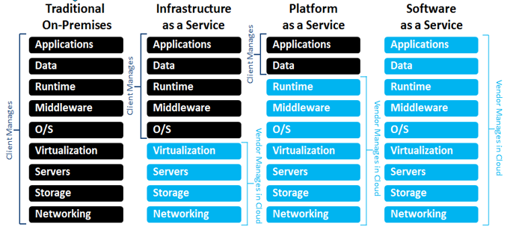
Cloud Services Models and IBM Cloud Offerings
Customization; higher cost; slower time to value
Standardization; lower cost; faster time to value
Notes:
Timing is critical if your apps (and the functionality they provide to your employees and/or customers) are to keep up with the new expectations and competition the app revolution has generated. This slide summarizes the components of each Cloud service model. The components in black are managed by clients, the service providers manage the components in blue for clients in cloud environment. Client has more control and higher customization on the left hand side of traditional on-pre model, has higher standardization and faster time to market on the right hand side of the SaaS model.

Slide 58
Traditional On-Premises – Core IT
Client Manages
Core IT
Code
Benefits
Fully customizable.
Few limitations.
Necessary for some solutions.
Existing Investments.
Data
Runtime
Middleware
Time Commitment
Weeks to setup and deploy.
Maintenance/upgrades of hardware and software.
OS
Virtualization
Servers
Storage
Networking
Time to initial deployment
~ Weeks
~ Days
~ Minutes
Notes:
Core IT represents everything you own and manage in your data centers (the full stack pictured here). This is still a critical part of enterprise IT - let’s take a look why it is beneficial and what it takes to manage all of this.
Traditional On-Premise Benefits -
As stable and customizable as the customer wants - the only main limitation is cost.
Necessary for certain solutions (Core IT still has value in many scenarios i.e. transaction processing)
Houses a lot of the investments most companies have already made (customer data, inventory, SAP, you name it).
Traditional On-Premise Time Commitment -
Typically takes weeks to setup an environment and deploy an initial app - customer manages entire stack pictured here
Have to maintain hardware and software as well (think environment uptime, fixes, and upgrades). Dedicated staff necessary.
Thus, Core IT doesn’t lend itself to the experimental nature of development in the cloud/app revolution
Core IT represents everything you own and manage in your data centers (the full stack pictured here). This is still a critical part of enterprise IT - let’s take a look why it is beneficial and what it takes to manage all of this.
Core IT Benefits
As stable and customizable as the customer wants - the only main limitation is cost.
Necessary for certain solutions (Core IT still has value in many scenarios i.e. transaction processing)
Houses a lot of the investments most companies have already made (customer data, inventory, SAP, you name it).
Core IT Time Commitment
Typically takes weeks to setup an environment and deploy an initial app - customer manages entire stack pictured here
Have to maintain hardware and software as well (think environment uptime, fixes, upgrades). Dedicated staff necessary.
Thus, Core IT doesn’t lend itself to the experimental nature of development in the cloud/app revolution

Slide 59

Infrastructure as a Services (IaaS)
Client Manages
Vendor Manages in Cloud
Infrastructure as a Service
Code
Benefits
Most control in the cloud.
Necessary for some solutions.
Infrastructure managed by SP.
Data
Runtime
Middleware
Time Commitment
Minutes to provision VM.
Time to configure software and apps varies.
Maintenance/upgrades of OS, middleware, runtime.
OS
Virtualization
Servers
Storage
Networking
Core IT
Time to initial deployment
~ Weeks
~ Days
~ Minutes
Notes:
Infrastructure as a Service (and specifically IBM’s acquisition of SoftLayer) was the cloud’s initial answer to the need for faster deployments, faster environment setup, etc… by abstracting the infrastructure from the customer. It manages infrastructure resources in a resource pool, with self-service provisioning, rapid elasticity, and as measured services. Virtualization alone does not accomplish this vision and set of characteristics. After all infrastructure resources are provided and managed as a set of capacity services, the data center can be treated as a true software-defined environment
IaaS Benefits
Networking, Storage, Server, Vitualization managed by service provider.
Most customizable cloud offering
Solutions where` customizability of OS, Middleware, or Runtime needed
IaaS Time Commitment
Customer sets up and manages OS, Middleware, and Runtime - these still take at least a matter of days to setup and reach an initial deployment
Maintenance/upgrades necessary as well

Slide 60
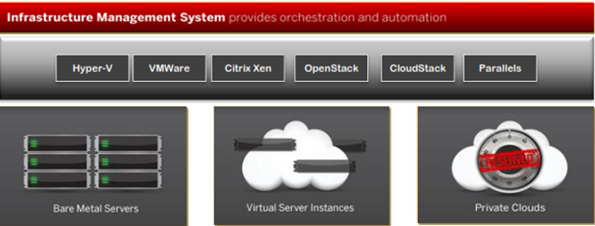
IBM SoftLayer IaaS Offerings
Highly flexible architecture
One platform for public cloud servers, private clouds, bare metal servers
Unified systems management & API
Technology-neutral platform
Support for broad range of operating systems, virtualization platforms
Notes:
SoftLayer is IBM’s BlueMix IaaS . SoftLayer provides:
Highly flexible architecture
One platform for public cloud servers, private clouds, bare metal servers
Unified systems management & API
Technology-neutral platform
Support for broad range of operating systems, virtualization platforms
Key Resources it offers including:
A dedicated bare metal server, custom configured to your spec: Wide selection, from low range to GPU, etc. You can install anything you want and use it as a building block
A Virtual Machine (VM, Cloud Computing Instance or CCI)
Off server Storage Options: NAS, SAN, Object storage
A private or hybrid cloud
Hardware Firewalls and Load Balancers
IP addresses, subnets, VLANs
Services: Backups, Vulnerability scans, Object Store, Monitoring, Messaging service, Content Delivery Network (CDN), Email delivery service, Anti-virus software, DNS entries

Slide 61

Platform as a Services (PaaS)
Client Manages
Platform as a Service
Vendor Manages in Cloud
Benefits
Setup environments and deploy apps very quickly.
Infrastructure and platform managed by Service Provider.
Code
Data
Runtime
Middleware
OS
Time Commitment
Minutes to setup and deploy.
Focus on your apps and their data.
Virtualization
Servers
Storage
Networking
IBM Bluemix PaaS Environment based on Cloud Foundry
Core IT
IaaS
Time to initial deployment
~ Weeks
~ Days
~ Minutes
Notes:
The concept of composable solutions in a Cloud Environment, which consists of finer grained services that can be recombined to create new capabilities, is a key element of the cloud. Composable environments can contain cloud services, which bring together operational, development, application, database, and third-party services – all with embedded monitoring and manageability capabilities.
PaaS Benefits -
Setup your environment and deploy apps quicker than any other offering
Service provider manages the Infrastructure AND the platform
PaaS Time Commitment -
Minutes to initial deployment - developer can handle everything on his/her own
Maintenance and upgrades of Platform and Infrastructure handled by service provider

Slide 62
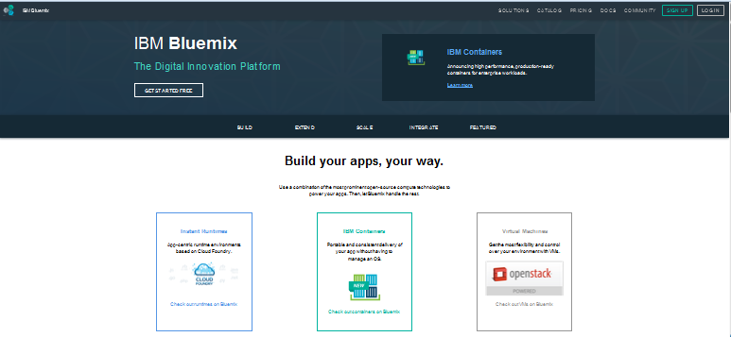
IBM Platform as a Service Offerings – Bluemix
Service catalog available on Bluemix
DevOps - From development to deployment
Big Data – Harness the power
Mobile – Quickly get started with your next app
Watson – Enable building cognitive apps
Business Analytics – Powerful analytics made easy
Data Management – Agile data mgmt. & refinement
Web and Application – Deliver new web & mobile apps
Security – Build security into application design
Internet of Things – A new generation of apps
Integration – Extend existing investments & Infrastructure
Developer experience
Rapidly deploy and scale applications in any language.
Compose applications quickly with useful APIs and services and avoid tedious backend config.
Realize fast time-to-value with simplicity, flexibility and clear documentation.
Enterprise capability
Securely integrate with existing on-prem data and systems.
Choose from flexible deployment models.
Manage the full application lifecycle with DevOps.
Develop and deploy on a platform built on a foundation of open technology.
Built on a foundation of open technology.
Notes:
Bluemix is IBM’s PaaS offering and atop of IBM SoftLayer to help you build, run, scale, manage, integrate & secure applications in the cloud.
It’s an open-standard, cloud-based platform for building, managing, and running applications of all types (web, mobile, big data, new smart devices, and so on). Bluemix brings a full suite of cloud services to one place, such as API management & Integration, DevOps, IoT, Cloud integration, Big Data and Analytics, Security and Watson to enhance development experience and provide enterprise capability.
So whether you’re creating apps for the web, for mobile, IoT or for Big Data, Bluemix can help you build them smarter and get them to market faster...
We will introduce detail Bluemix capabilities in later of this section.

Slide 63
Software as a Services (SaaS)
Software as a Service
Vendor Manages in Cloud
Benefits
Sign up and rapidly start using business applications.
Access apps and data from any connected end points
No data is lost if computer breaks
The service is able to dynamically scale to usage needs
No longer have to install, update and maintain the software
Code
Data
Runtime
Middleware
OS
Virtualization
Servers
Storage
Networking
Core IT
IaaS
PaaS
Time to initial deployment
~ Weeks
~ Days
~ Minutes
Notes:
SaaS is place where software providers share IT resources such as application software /services between customers to enable self-service, rapid elasticity, and pay-per-use pricing.

Slide 64
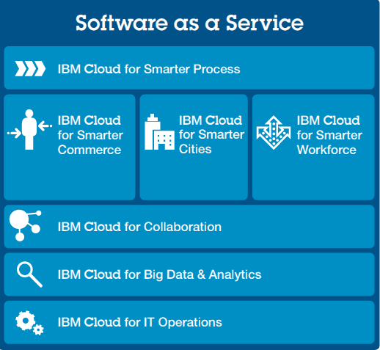
IBM Cloud SaaS Portfolio
Notes:
while most companies see the value of SaaS for specific needs, IBM delivers a broad portfolio of SaaS solutions around Big Data & Analytics, IT Operations, Business Process, Smarter Commerce, Smarter Cities, Smarter Workforce and social business, that can be deployed as part of a deeper business strategy to transform every aspect of an organization. With a robust cloud portfolio and proven track record in the industry, IBM is committed to delivering an innovative SaaS experience that combines the agility, compatibility and cost efficiency needed for every organization’s success now and into the future.
The IBM Cloud SaaS portfolio consists of five major categories with many unique applications, each designed to address unique business processes, industries and functions:
Business Process as a Service - Rely on BPaaS tools to manage specific industry solutions that streamline efficiencies, unify business processes and enhance customer experience.
IBM Cloud for Smarter Commerce - Leverage the power of the cloud to drive more meaningful interactions with customers and suppliers across every facet of the value chain: buy, market, sell and service.
IBM Cloud for Smarter Cities: Flexible, cost-effective SaaS solutions grow with a city’s demands and deliver the powerful data needed to efficiently manage resources and make informed, proactive decisions.
IBM Cloud for Social Business: Increase innovation and accelerate decision making by unifying human capital to build high-functioning communities.
IBM Cloud for Smarter Analytics: Facilitate better decisions, increased efficiency and faster innovation across the enterprise by delivering the right data to the right people more effectively and economically than ever.
With a robust cloud portfolio and proven track record in the industry, IBM is committed to delivering an innovative SaaS experience that combines the agility, compatibility and cost efficiency
needed for every organization’s success now and into the future.

Slide 65
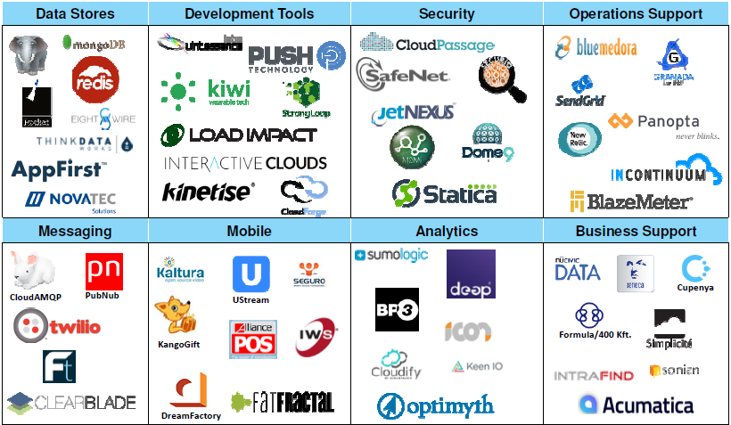
IBM Cloud Marketplace – Cloud Services Store
Is a dedicated area on ibm.com/cloud for IBM customers to discover enterprise cloud services that run on or are deployable on SoftLayer or integrated with Bluemix and are available from IBM & Business Partners. ibm.biz/newway4partners
Notes:
IBM Cloud marketplace is a customer facing cloud services store where the service providers (IBM or Business Partners) can publish their cloud services, and consumers (also called clients) can purchase these services.
IBM’s marketplace contains a variety of Software as a Service products that can be up and running within minutes of ordering. The services published on Market place are from both IBM and Business partners shown on the slide. More partners are publishing their applications as service on IBM Cloud Marketplace.
We have a limited preview of the IBM Cloud partner marketplace. You can Nominate your cloud offering now at ibm.biz/newway4partners.
We are working with partners who are creating API-based services which can be used by developers, such as location services and e-signature.
We are looking for cloud services that simplify, optimize and accelerate the cloud experience.
The IBM Cloud partner marketplace is available now in limited preview for partners who qualify - Nominate your cloud offering now at ibm.biz/newway4partners.
Details are in development, but the commercial model will likely follow established marketplace models.

Slide 66














Timing is Critical …so are all of your other investments
Leverage the power of Bluemix without abandoning what you already use.
Core IT
IaaS
PaaS
IBM Bluemix
Notes:
While timing is critical (what we just discussed), the systems and data you use today can’t be forgotten. That’s why Bluemix simply and securely connects to core IT and even other clouds (leveraging IBM’s proven reputation as a systems integrator).
Hybrid cloud, where Public and Private clouds work together with Core IT investments, is critical to success given the app revolution and the expectations and increased competition it has generated.
Overall, hybrid cloud represents the “New IT…”

Slide 67
Bookmarks & References
http://www.ibm.com/cloud-computing/us/en/
http://www.ibm.com/cloud-computing/us/en/iaas.html
http://www.ibm.com/cloud-computing/us/en/paas.html
http://www.ibm.com/cloud-computing/us/en/saas.html
http://www.ibm.com/developerworks/cloud/library/cl-open-architecture/
http://www.ibm.com/cloud-computing/us/en/open-cloud-essentials.html
https://www.bluemix.net
https://www.ng.bluemix.net/docs/#starters/index-gentopic4.html#genTopProcId5
https://www.ng.bluemix.net/docs/#starters/index-gentopic3.html#container_ov
https://www.docker.com/
https://www.clouddoundry.org/
Notes:
Here’s a list of useful bookmarks on the topics we covered in this section for your reference.

Slide 68
QUESTIONS?
https://ibm.biz/BdXGBL
Get help from Bluemix development team and Stack Overflow community
Notes:
Please post your questions or find the answers on Bluemix Community https://ibm.biz/BdXGBL

